Slide 1
Combinational logic circuits
Presentation on

Slide 2
Types of combinational logic circuits
Adders
Subtractor
Half Adder
Full Adder
Half subtracror
Full subtractor

Slide 3
Firstly we discuss about Adder
Definition of adder:
Adders are the combinational logic circuits which are used for adding two or three binary bits.
Types of Adder:
Half adder
Full adder

Slide 4
HALF ADDER
Definition of Half adder: Half adder add two binary digits and produces two binary outputs called sum and carry.
It generates sum(s) and carry(c) as output.
Block Diagram:
Half adder

Slide 5
Truth table
Input bits |  | output
A | B | sum | carry
0 | 0 | 0 | 0
0 | 1 | 1 | 0
1 | 0 | 1 | 0
1 | 1 | 0 | 1

Slide 6
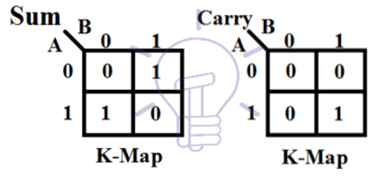
K-Map for half adder

Slide 7
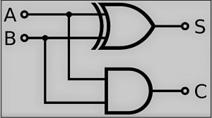
Logic expressions: s=A’B+AB’
Logic Diagram:

Slide 8
Full Adder
Full adder has three input bits A,B and additional carry-in(in)
It is used to add three bits and generate two output sum(s),carry(c)
Block diagram:
sum
Inputs outputs
carry
Full adder

Slide 9
Truth table
Inputs bits |  |  | outputs
A | B | C | Sum | carry
0 | 0 | 0 | 0 | 0
0 | 0 | 1 | 1 | 0
0 | 1 | 0 | 1 | 0
0 | 1 | 1 | 0 | 1
1 | 0 | 0 | 1 | 0
1 | 0 | 1 | 0 | 1
1 | 1 | 0 | 0 | 1
1 | 1 | 1 | 1 | 1

Slide 10
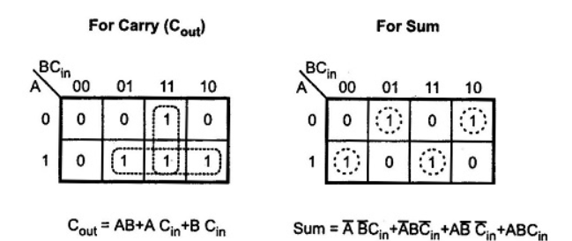
K-map

Slide 11
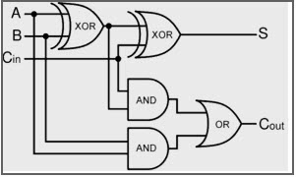
Logic Diagram

Slide 12
Download ppt’s and handwritten notes
JP Web devolpers
Follow on instagram:-@jpwebdevelopers
Thank
you

