Slide 1
PRESENTATION On
ER-MODEL

Slide 2
ER-model
The entity-relationship model (or ER model) is a way of graphically representing the logical relationships of entities in order to create a database.
ER-modelling is a data modelling technique used in software engineering to produce a conceptual data model of a information system.
ER (Entity Relationship) Model are represented by ER diagram (Entity Relationship Diagram).

Slide 3
Basic Concept of ER-Model:
Entity: An Entity may be an object with a physical existence – a particular person, car, house, or employee.
Entity Type: The basic concept of the ER model is the entity type that is used to represent a group of ‘objects’ in the ‘real world’ with common properties.

Slide 4
Types of Attributes:
Simple attribute − Simple attributes are atomic values, which cannot be divided further.
For example, a student's phone number is an atomic value of 10 digits.
Composite attribute − Composite attributes are made of more than one simple attribute.
For example an Address attribute of student Entity type consists of Street, City, State, and Country.

Slide 5
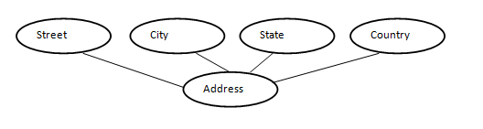
Types of Attributes:
In ER diagram, composite attribute is represented by an oval comprising of ovals.
3. Derived attribute − Derived attributes are those attributes whose values are derived from other attributes . For example, age can be derived from date_of_birth.

Slide 6

Types of Attributes:
In ER diagram, derived attribute is represented by dashed oval.
4. Single-value attribute − Single-value attributes contain single value. For example − Roll no. of student.
5. Multi-value attribute − Multi-value attributes may contain more than one values. For example, a person can have more than one phone number, email_address, etc.

Slide 7


Types of Attributes:
In ER diagram, multi-valued attribute is represented by double oval.
6. Key Attribute:The attribute which uniquely identifies each entity in the entity set is called key attribute.
For example, Roll_No will be unique for each student. In ER diagram, key attribute is represented by an oval with underlying lines

Slide 8

Relationship:
The association among entities is called a relationship. For example, an employee works_at a department, a student enrolls in a course. Here, Works_at and Enrolls are called relationships.
In ER diagram, relationship is represented by a diamond and connecting the entities with lines.

Slide 9
Mapping Cardinality:
The number of times an entity of an entity set associates in a relationship set is known as cardinality. Cardinality can be of different types:
one-to-one − One entity from entity set A can be associated with at most one entity of entity set B and vice versa.
Example:“Student allotted a project”
1 1
allot
Project
Student

Slide 10
Mapping Cardinality:
One-to-many − One entity from entity set A can be associated with more than one entities of entity set B however an entity from entity set B, can be associated with at most one entity.
“A department recruits faculty” is a one-to-many relationship because a department can recruit more than one faculty, but a faculty member is related to only one department.
1 N
recruits
Faculty
Department

Slide 11
Mapping Cardinality:
Many-to-one − More than one entities from entity set A can be associated with at most one entity of entity set B, however an entity from entity set B can be associated with more than one entity from entity set A.
Example:Student enrolls one Course but a Course can have many Students.
N 1
enroll
Course
Student

Slide 12
Mapping Cardinality:
Many-to-many − More than One entity from A can be associated with more than one entity from B and vice versa.
Example: “Author writes books” is a many-to-many relationship because an author can write many books and a book can be written by many authors.
M N
enroll
Student
Student

Slide 13
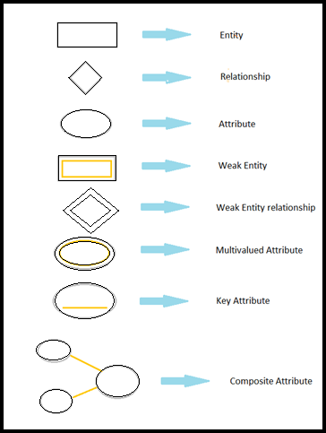
Symbols and Notations:

Slide 14
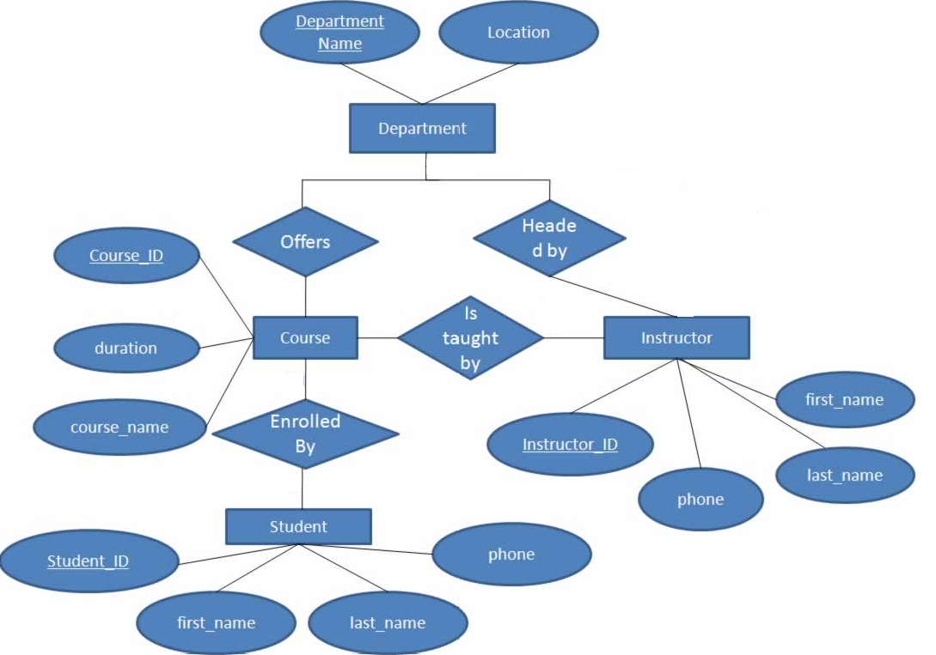
Er-diagram:
1
1
N
1
M
N

Slide 15
Data dictionary
Data dictionary is the centralized collection of information about data.
It contains descriptions and definitions concerning the data elements, data structure,their interrelationships and other characteristics of a system.
Data dictionary is reference work of data about data (meta data).

Slide 16
Data dictionary contents
Data dictionary contains
Data Elements
Data structure
Data flow
Data store

Slide 17
Data elements
Data elements are smallest unit of data that has some meaning.
It consist of name and descriptions of data and Internal or external data stores etc.
It is the smallest unit of data has some meaning.

Slide 18
Data structure
Data structure are a group of data elements that describe a unit in the system.
An algebraic notation is used to represent the data structure.
Structural record and general structural record used.

Slide 19
Data flow
Each data flow should be defined with descriptive information and it’s composite structure or elements.
It includes the following information:
ID:- identification number
label :- the text that should appear on the diagram
A general description of the data flow.
The source of data flow this could be an external entity, a process, or a data flow coming from data store.
The destination of the data flow.

Slide 20
Data store
It stores the information from where the data
enters into the system and exit out of the system.
The data store may include
-> Files
-> Tables

Slide 21
Download Ppt’s
jpwebdevelopers.in
Follow us
@jpwebdevelopers
Email
jpdevelopers2020@gmail.com
Thank
You

