Slide 1
PRESENTATION On
Software metrics

Slide 2
SOFTWARE METRICS
A software metrics is a measure of software characteristics which are quantifiable or countable. Software metrics are important for many reasons, including measuring software performance, planning work items, measuring productivity and many other uses.
Software metrics are related to four functions of management: -Planning, Organization, Control, or Improvement.

Slide 3
SOFTWARE METRICS CLASSIFICATION
Software metrics can be classified generally into following categories:-
Product Metrics
Process Metrics
People Metrics

Slide 4
Product Metrics:-
Product Software Metrics are those used to build artifacts like requirement specification documents, system design documents of a software system.
Software Product Metrics helps in various ways:-
As a predictor of source requirements for later parts of the project.
As a quality assurance enforcement mechanism.

Slide 5
As a mechanism of evaluating the performance of staff on a software project.
Helping programmers and development staff gain a quantitative estimate of the quality of their work.
As the basis for intelligent and semi-intelligent software development tools.

Slide 6
Products metrics can be viewed as either internal attributes or external attributes.
Internal attributes :-
are those can be measured purely in term of the product itself separate from its behavior.
External attribute:-
are those that can be measured with respect to its environment

Slide 7
Product Metrics can be categorized as:-
Size Metrics:-
1. Line of code
2. Token Metrics
3. Function Points
Control Complexity Metrics
1. McCabe's Cyclomatic Complexity
2. Temporal Metrics
3. Information Flow
Quality Metrics
1. Defect Metrics
2. Reliability Metrics
3. Maintainability Metrics

Slide 8
1.Size Metrics
These metrics aim to measuring software size.
Lines of code:-
(i) LOC measure is used to measure size.
Version of LOC:-
DSI (Delivered Source Instruction)
KDSI(Thousands of Delivered Source Instruction)
Advantage:- Simple to measure.
Disadvantage:- language dependent & difficult to understand.

Slide 9
(II)Token Metrics:-
Token metrics are calculated by counting tokens in the source code of system .
A token is simple entity that makes up a program.

Slide 10
(III)Function Points:-
Function data is an estimation variable that is used to “size” each element of the software.
As baseline metrics collected from past projects and used in conjunction with estimation variables to develop cost and effort projections.
Advantages:- Language independent and more accurate.
Disadvantages:- Subjective counting and ignore quality of output.

Slide 11
2.Control Complexity Metrics:-
In control flow metrics , each program unit in a software system is explored and the flow control determined.
(I) McCabe’s Cyclomatic Numbers, V(G):-
It measure of the complexity of a program was developed by (McCabe 1976). He developed system that he called the Cyclomatic Complexity of a program. This system measures the number of independent paths in program , thereby placing a numerical value on the complexity.

Slide 12
The Cyclomatic Number, V(G), of graph G may be computed according to formula:-
V(G)= e-n+2p
e=number of edges in the control flow graph
n= number of nodes
p= total number of strongly connected components.

Slide 13
1. Program Control flow Graph(CFG):-
CFG consists of nodes and edges.
Nodes represents a straight-line section of code.
Edges represents a possible sequence of execution.
Sequential statements could be put altogether.
The decision making statements should be branched into false and true indicating part a and part b respectively of that statement.1

Slide 14
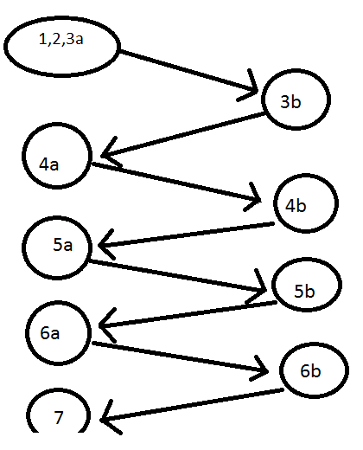
For Example:-

Slide 15
Cyclomatic Number Calculation
Number of edges, e=12;
Number of nodes, n=9;
Number of strongly connected components, p=1;
Cyclomatic Number, V(G)= 12-9+1=5

Slide 16
2. Temporal Metrics
Temporal metrics measure the difficulty of getting the information required to solve a programming problem into short-term-memory(STM) at once.
Information Flow Metrics
Information flow metrics are used for program complexity . Fan-in and Fan-out method counts the number of local information flows entering and exiting each procedure.
Complexity is defined as:-
Complexity=(Procedure length)*(Fan-in *Fan-out)pow2

Slide 17
Process Metrics
Process metrics are measure the development process that creates a body of software . A common example of a process metric is the length of time that the process of software creation takes.
Process metrics can be used to estimate, monitor and improve the reliability and quality of software.

Slide 18
People Metrics:-
People metrics is also called personnel metrics.
The goal of the people metrics is to keep staff happy , motivated and focused on the risk at hand . These metrics are further classified as follows:-
Programming Experience Metrics:-
1.Programming Language Experience
2.Management Experience

Slide 19
Communication Level Metrics
Teamwork Experience
Communication hardware/software level
Personal availability
Productivity Metrics
Size Productivity
Quality vs. Productivity
Team Structure Metrics
Hierarchy metrics
Team Stability metrics

Slide 20
Download Ppt’s
jpwebdevelopers.in
Follow us
@jpwebdevelopers
Email
jpdevelopers2020@gmail.com
Thank
You

