Slide 1
PRESENTATION On
SPIRAL MODEL

Slide 2
Contents
Spiral Model
History
Why to use spiral model
Phases
Advantages
Disadvantages
Conclusion
Comparison

Slide 3
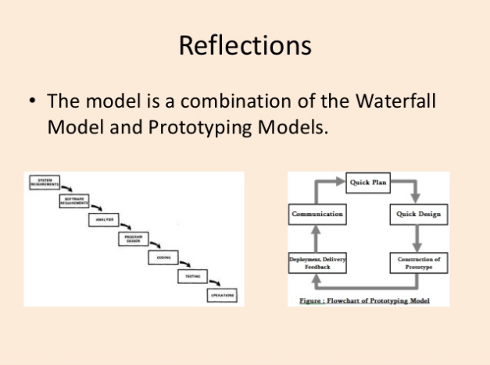
Spiral model is the combination of Waterfall Model and Prototype Model

Slide 4
Spiral Model
“Spiral model is the Risk Driven model. This model is best used for large projects which involves continues enhancements.”
Each phase in spiral model begins with a design goal and ends with the client reviewing the progress.

Slide 5
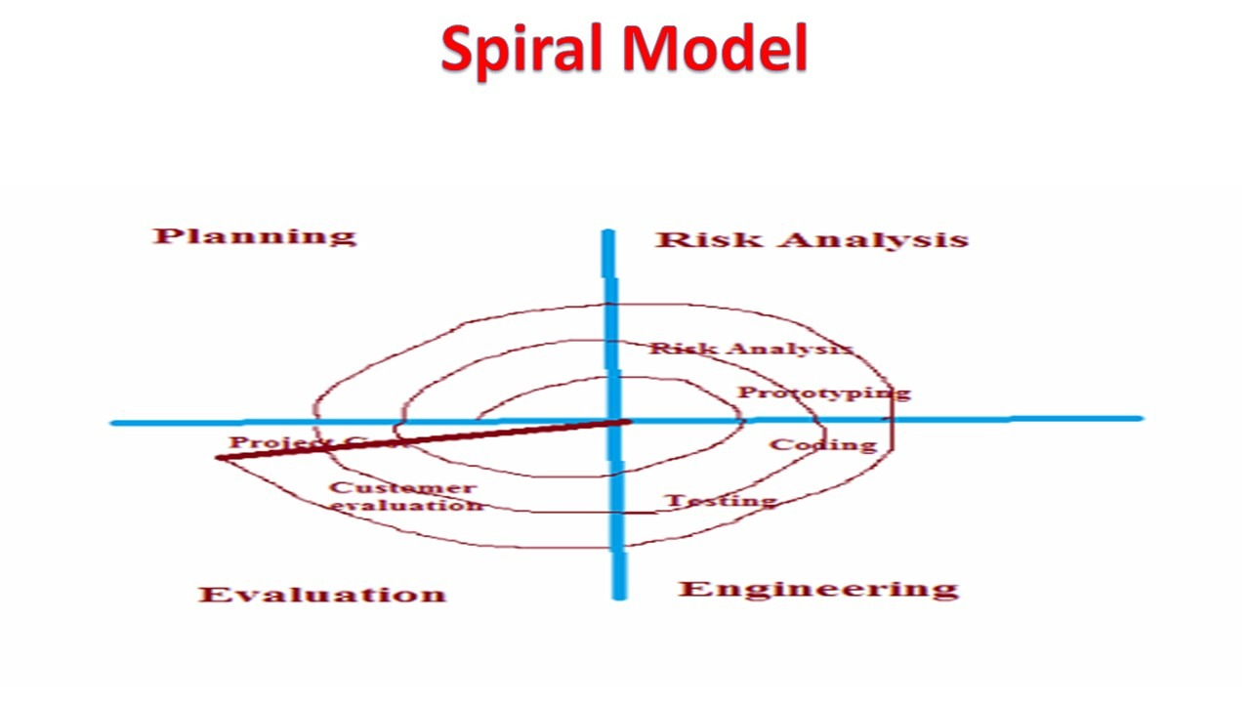

Slide 6
History
Background on software process models
1950 ：Code-and-fix model
1956 ： Stage wise model (Pennington )
1970 ： Waterfall model (Royce)
1971 ： Incremental model(Mills)
1977 ： Prototyping model(Bally and others)
1988 ： Spiral model(Boehm)

Slide 7
Conti…..
The spiral model was first mentioned by Barry Boehm in his 1986 paper.
This Model was not first model to discuss iterative development , but it was the first model to explain why the iteration matters.

Slide 8
Spiral model : Appropriate usage
When there is a budget Constraint and risk evaluation is important.
For medium to high risk projects.
Customer is not sure of their requirements which is usually the case.

Slide 9
When to use Spiral Model?
Where enough time frame is their..
When the project is large.
When requirements are unclear and complex.
When changes may require at any time.
Large and high budget projects.

Slide 10
A spiral model has 4 phases described below:
Planning phase
Risk analysis phase
Engineering phase
Evaluation phase.

Slide 11
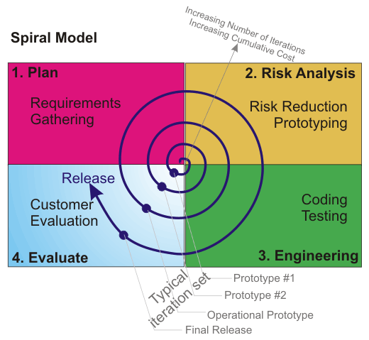

Slide 12
1. Planning:-
Gathering of requirements through consistent interaction with the client and stakeholders.
Feasibility study.
Study and analysis of these requirements, to estimate the budget, resource, time, etc., required in the software development.

Slide 13
2. Risk Analysis:-
This Phase Identify and resolve all the possible risks in the project Development.
In the risk analysis phase, a process is undertaken to identify risk and alternate solutions. A prototype is produced at the end of the risk analysis phase. If any risk is found during the risk analysis then alternate solutions are suggested and implemented.

Slide 14
3. Development & Test:-
It is an important phase of this model, where all the requirements, strategies and plans are implemented and executed, so as to develop the software product.
It includes testing, coding and deploying software at the customer site

Slide 15
4. Evaluation:-
This phase involves the software product interaction with the customers, who assess them and accordingly, provide their feedbacks, which helps in determining the requirements or features that needs to be added or removed from the software.
This phase is very much similar to Testing phase.

Slide 16
Advantages
High amount of risk analysis .
Good for large and mission-critical projects.
Flexibility in Requirements.
Customer Satisfaction.
Larger projects / software are created and handled in a strategic way
Control towards all the phases of development.
More and more features are added in a systematic way.

Slide 17
Disadvantages
Can be a costly model to use.
Risk analysis requires highly specific expertise.
Project's success is highly dependent on the risk analysis phase.
Doesn't work well for smaller projects.

Slide 18
Conclusion:
This model is very good to use for larger projects where you can develop and deliver smaller prototypes and can enhance it to make the larger software.
The implementation of this model requires experienced resources as risk analysis is a very integral part of this model and risk analysis requires expertise and as a result this model becomes costly.

Slide 19
Download Ppt’s
jpwebdevelopers.in
Follow us
@jpwebdevelopers
Email
jpdevelopers2020@gmail.com
Thank
You

