Slide 1
PRESENTATION On
BLACK BOX TESTING

Slide 2
Contents….
Black box Testing
Types of Black Box Testing
How to perform Black Box Testing
SDLC of Black Box Testing
Black box testing Techniques

Slide 3
BLACK BOX TESTING…..
Definition of Black Box Testing:-
Black Box Testing is a method of software testing that examines the functionally of an application (e.g. what the software does)without peering into its internal structures or workings .
Black Box Testing is based entirely on the software requirement , and specifications.

Slide 4
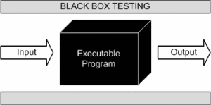
DIAGRAM…

Slide 5
Types Of Black Box Testing
There are many type of Black Box Testing but following are the prominent ones :-
Functional Testing
Non-functional Testing
Regression Testing

Slide 6
Functional Testing…
This black box testing type is related to functional requirements of a system ,it is done by software testers.
NON-FUNCTIONAL TESTING….
This type of black box testing is not related to testing of a specific functionally, but non-functional requirements such as performance, scalability, usability.
REGRESSION TESTING….
Regression testing is done after code fixes, upgrades or any other system maintenance to check the new code has not affected the existing code.

Slide 7
Black Box Testing And Software Development Life Cycle (sdlc)
Black box testing has its own life cycle called Software Test Life Cycle (STLC) and it is relative to every stage of Software Development Life Cycle.
There are four stages.....
Requirement
Test Planning & Analysis
Design
Test Execution

Slide 8
Black Box Testing Techniques…
Following are the prominent Test Techniques
amongst the many used in Black Box Testing :--
Equivalence Class Partitioning
Boundary Value Analysis
Cause-Effect Graphing

Slide 9
Equivalence Partitioning…
Equivalence class partitioning is a black-box testing
technique or specification based testing technique
in which we group the input data into groups or equivalence classes .
This technique is also known as Equivalence Class Partitioning (ECP) .
Hence, instead of using each and every input value we can now use any one value from the group/class to test the outcomes . In this way , we can maintain the test coverage while we can reduce a lot of rework and most importantly the time spent.

Slide 10
Contd.....
An advantage of this approach is reduction in time required for testing due to lesser number of test cases.
It reduces the number of test cases without compromising the test coverage or quality of testing.
In this technique , input values to the system or application are divided into different classes or group based on its similarity in the outcome.

Slide 11
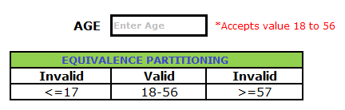
For example :--

Slide 12
2. Boundary Value Analysis….
Boundary value analysis is also a black box testing technique, closely associated with Equivalence Class Partitioning .
From the name itself , we can understand that in this technique we focus on the values at boundaries as it is found that many applications have a high amount of issues on the boundaries.
Boundary means the values near the limit where behaviour of the system changes in boundary value analysis both the valid inputs and invalid inputs are being tested to verify the issues.

Slide 13
Contd….
It is easier and faster to find defects as the density of defects at boundaries is more.
The overall test execution time reduces as the number of test data greatly reduces.
The test cases generated through Boundary Value Analysis are very small.
But ,the dependencies with BVA are not tested between two inputs. And, this technique doesn’t fit well when it comes to Boolean Variables.

Slide 14
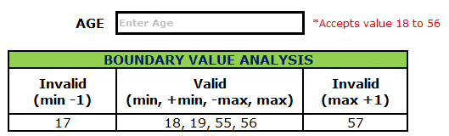
For example :--

Slide 15
3. Cause-Effect Graphing…
Cause-Effect Graphing is also a Black box testing technique.
Cause effect graph is a technique that graphically illustrates the relationship between a given outcomes and all the factors that influence the outcome.
It is also known as Ishikawa diagram as it was invented by Kaoru Ishikawa or fish bone diagram because of the way it looks.
It is generally use for hardware testing but now adapted to software testing, usually tests external behaviour of a system.

Slide 16
Contd…..
The technique starts with identifying causes and effects of the system under testing. A causes is a distinct input condition, and an effects is a distinct outputs condition . Each condition forms a node in the cause-effect graph.

Slide 17
Contd…..
We can identify the following causes and effects from there requirements.
Causes:
c1. Command is credit
c2. Command is debit
c3. Account number is valid
c4. Transaction_amt is valid
Effects:
e1. Print “invalid command”
e2. Print “invalid account_number”
e3. print “debit amount not valid”
e4. Debit account
e5. Credit account

Slide 18
Download Ppt’s
jpwebdevelopers.in
Follow us
@jpwebdevelopers
Email
jpdevelopers2020@gmail.com
Thank
You

