Slide 1
Presentation ON Inheritance in C++

Slide 2
Inheritance in C++
The capability of a class to derive properties and characteristics from another class is called Inheritance.
New class is also known as sub class or drive class.
Old class is also known as super class or base class .

Slide 3
Types of Inheritance
Single Inheritance
Multiple Inheritance
Multilevel Inheritance
Hybrid Inheritance
Hierarchical Inheritance

Slide 4
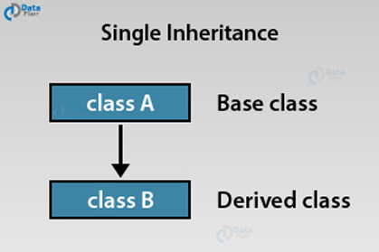
Single Inheritance
To drive a class from an existing base class is called single inheritance.

Slide 5
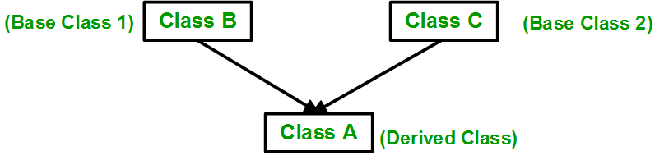
Multiple Inheritance
To drive class inheriting from multiple base class is called multiple inheritance

Slide 6
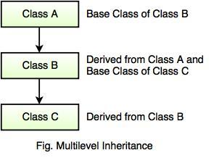
Multilevel Inheritance
To drive class inheriting from a class that inherits from another class is called Multilevel Inheritance

Slide 7
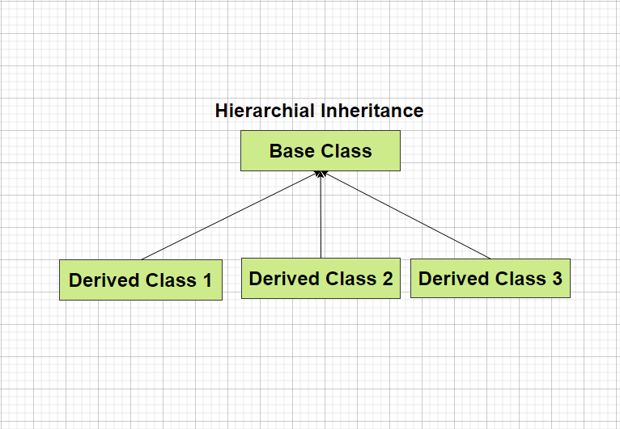
Hierarchical Inheritance
In this multiple derived classes inherits from a single base class.

Slide 8
Hybrid Inheritance
Hybrid inheritance is combination of hierarchical and multilevel inheritance.

Slide 9
Thank
You
Download ppt’s and handwritten notes
JP Web devolpers
Follow on instagram:-@jpwebdevelopers

