Slide 1
PRESENTATION ON
WHITE BOX TESTING

Slide 2
WHITE BOX TESTING
White box testing is a method of testing software that tests internal structure or working of an application.
It is also known as clear box, glass box, transparent box testing and structural testing
This type of testing is mainly done by the developers.
To test internal structure.
The traversal of all independent paths atleast once.
Evaluates all logical decision & find whether they are true or false.
Evaluates all loops to check their boundaries.
Evaluates all internal data structure to confirm their validity.

Slide 3
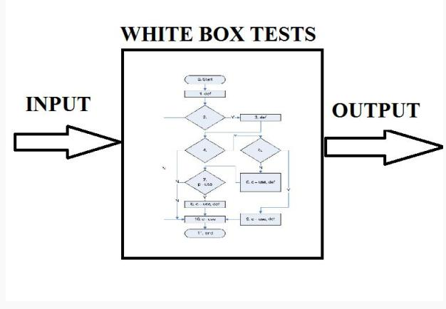
Working of white box testing

Slide 4
TYPES OF WHITE BOX TESTING
Control flow/Coverage testing.
Data flow based testing.
Mutation testing.

Slide 5
Control flow Testing
The most common way to device good white –box test cases is to consider control flow of the program.
The control flow of a program is represented in a control flow graph.
It consist of the following components.
Node:-A node in this graph represents a block of statements that is always executed together.
Edge:- possible transfer of control after executing last statement of block represented by node i to the first statement of block represented by node j.

Slide 6
CONT…
Path:-finite sequence of nodes.
Exit node:-Node corresponding to a block whose last statement is exit statement.
Complete path:-A path whose first node is the start node and the last node is the exit.

Slide 7
Now we consider some criteria's
Statement coverage
Branch coverage
Condition coverage

Slide 8
Statement coverage
Execute all statements in a program at least once during testing. The coverage criteria is not very strong, and can leave errors undected.
For example:-if there is an if statement in the program without having an else clause, the statement coverage criterion for this statement will be satisfied by a test case that evaluate the condition is true. No test case is needed that ensure that the condition if statement evaluates to true.

Slide 9
Cont….
For exp:-
int abs (x)
Int x;
{
(x>=0) x=0-x;
return (x)
}
This program is clearly wrong. suppose we executed the function with the set of test cases{x=0}(i.e., the set has only one case). The statement coverage criterion will be satisfied by testing with this set, but the error will not revealed.

Slide 10
Branch coverage
Branch coverage can requires that each decision in the program be evaluated to true and false values at least once during testing.
For exp:-
int check(x)
int x;
{
if ((x >=)&&(x<=200))
check =true;
else check=False
}

Slide 11
Cont…..
The modules is in correct ,as it is checking for x<=200 instead of 100(perhaps a typing error made by the programmer).suppose the module is tested with the following set of test cases:{x=5,x=-5}.The branch coverage criterion will be satisfied of this modules by this set.

Slide 12
Condition coverage
It basically deal with errors which remain undected during branch testing because some errors are related to some combination of branches and their presence is only revealed by an execution of flow through a path that follow all if combinations of those branches. so in condition coverage all possible paths in a control flow graph should be executed during testing.

Slide 13
DATA FLOW BASED TESTING
In the data flow based testing approches,beside the control flow, information about where the variable are defined, and where the definition are used to specify the test case.
Data flow based criteria ,a definition-use graph(def/use graph, for short)for the program is first constructed from the control flow graph of the program.
def represents the definition of a variable. The variable on left-hand side of an assignment statement is the one getting defined.

Slide 14
Cont….
C-use represents computational use of a variable. Any statement( e.g., read, write an assignment)that use the value of variables for computational purpose is said to a making c-use of a variable. In an assignment statements, all variables on the right-hand side have a c-use occurrence. In a read and write statement, all variable occurrence are of this type.
p-use represents predicate use.These are all the occurrences of the variables in a predicate, which is used for transfer of control.

Slide 15
Cont….
all-paths(path coverage)
all-uses
all-c-uses/c som all-p-uses/c
all-defs all-p-uses
all-edges(branch coverage)
all-nodes(statement coverage)

Slide 16
Mutation Testing
The mutation operations are used to introduce change in the program or specification.
Mutation testing is a another testing technique .
In control flow-based and data flow-testing, the focus was on which path to executed during testing.
The changed program is called mutation testing.
The goal of testing is to make sure that during the course of testing , each mutant produces an output different from the output of the original program.

Slide 17
Cont…
Examples of mutation operations are:-replace an arithmetic operator with some other arithmetic operator{+,-,*,/}
a=b*(c-d)

Slide 18
Advantages of white box testing
This type of testing is mainly done by the developers.
It can improve the stability and reusability of test cases provided the object of an application remain the same.
It helps in optimizing the code.
Helps in removing the extra lines of codes which can bring in hidden defects.

Slide 19
Disadvantages of white box testing
As knowledge of code and internal structure is necessary therefore it requires highly skilled tester to test cases, which in increases cost.
It is nearly impossible to look into every bit of code to find out hidden errors which may cause problem, resulting in failure of application.
It is difficult to maintain white box testing, as it requires specialized tools like code analyzers and debugging tools.

Slide 20
Download Ppt’s
jpwebdevelopers.in
Follow us
@jpwebdevelopers
Email
jpdevelopers2020@gmail.com
Thank
You

